Slide 1
Hypertext Markup Language (HTML)
Day 1

Slide 2
Overview of Web Applications
Notes:
Have them open the inspector and try this activity

Slide 3



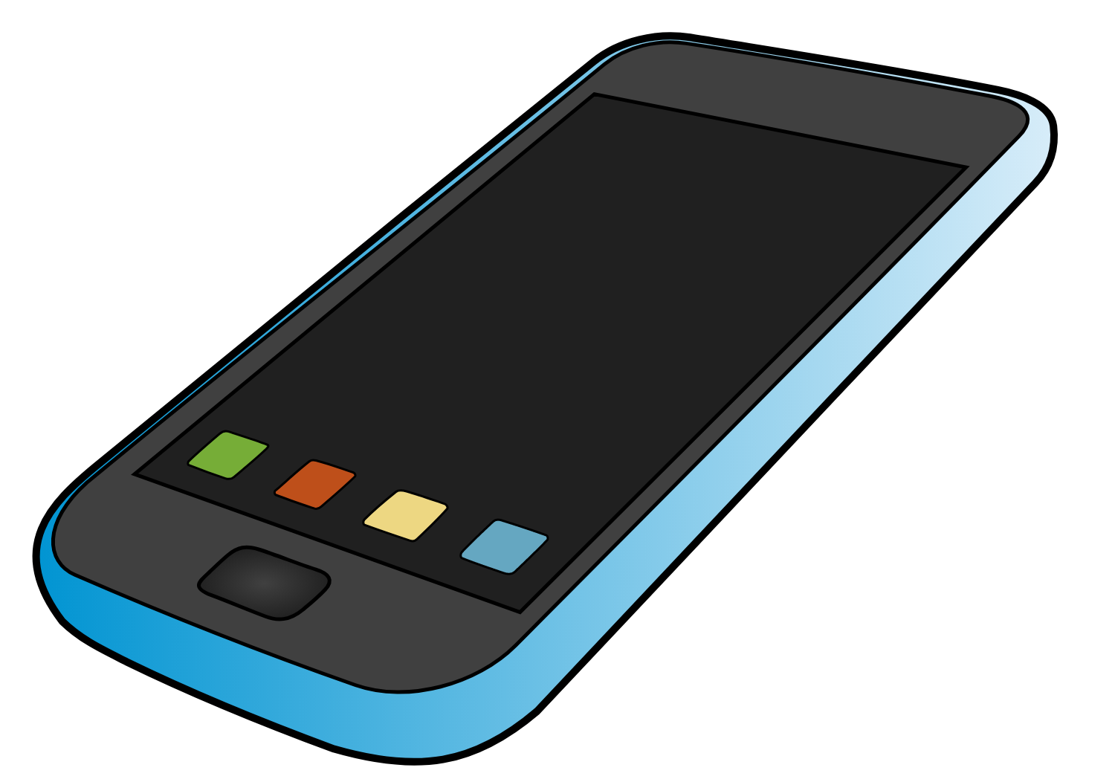





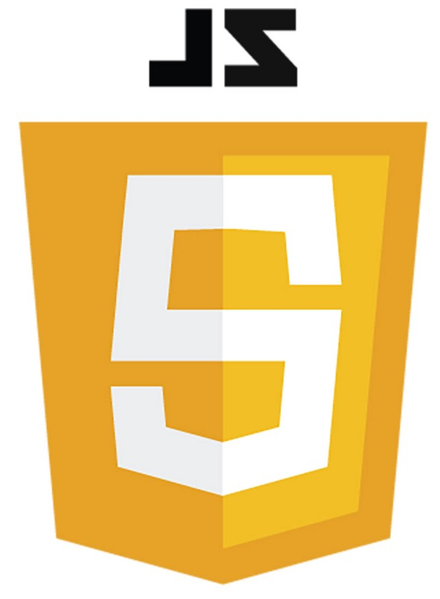

Frontend
(Client)
Request
Backend
(Server)
Response
Internet

Slide 4


Slide 5
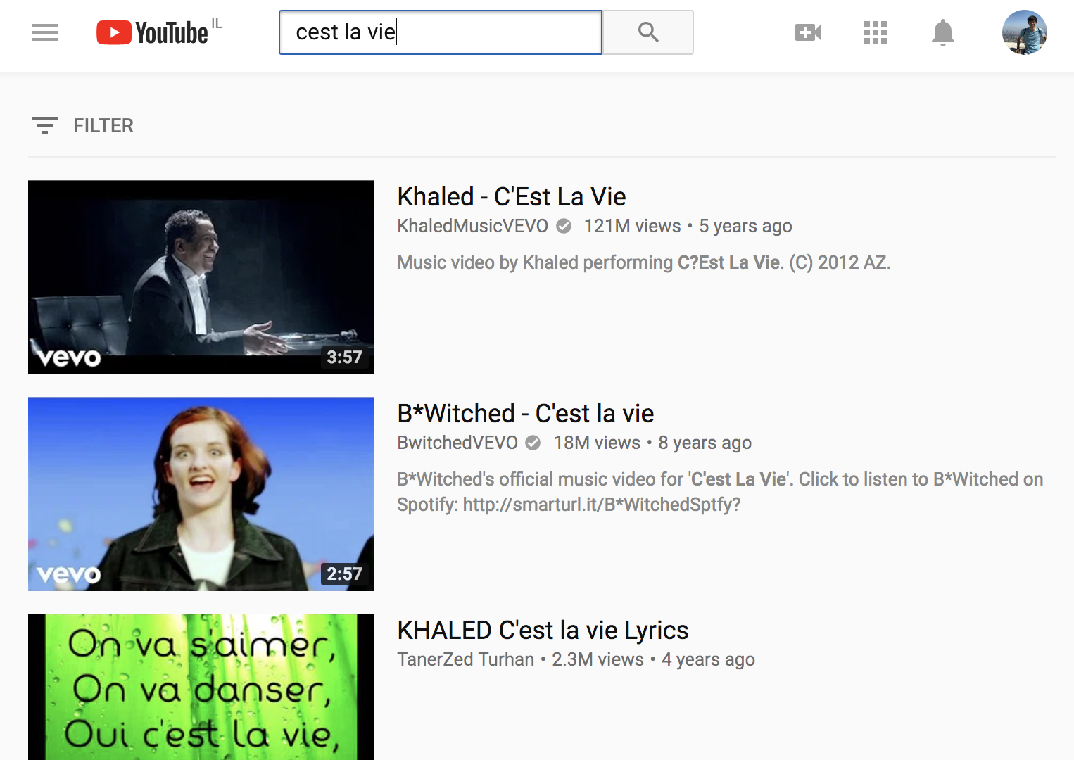


Frontend
(Client)
C’est la vie
Backend
(Server)
Videos
Internet
Search Algorithms, User Login and Info, and more
Databases of Videos

Slide 6
Frontend
(Client)
Request
Backend
(Server)
Response
Internet

Slide 7


Slide 8
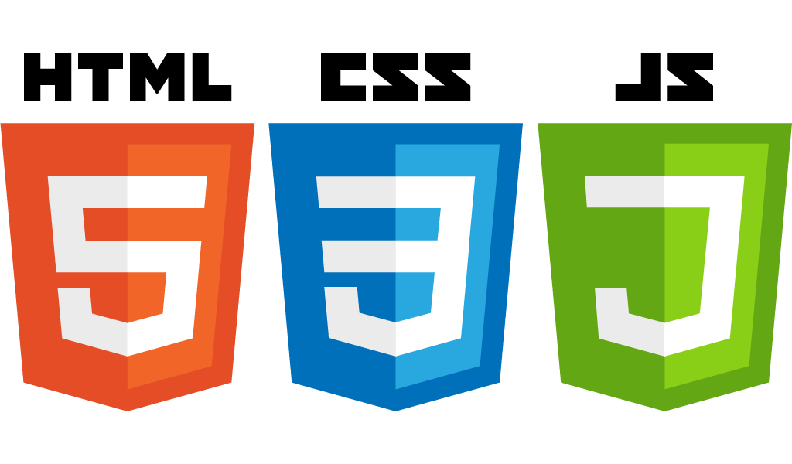
Content
Appearance
Interaction

Slide 9
Notes:
What do you think is the content, appearance, interaction in this page?

Slide 10
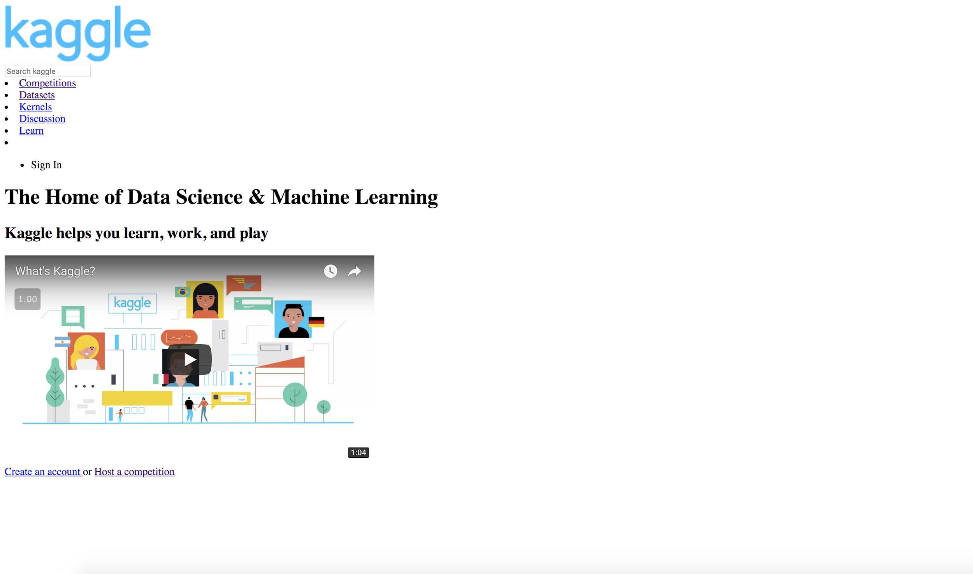
Notes:
Have them remove CSS on their own using

Slide 11
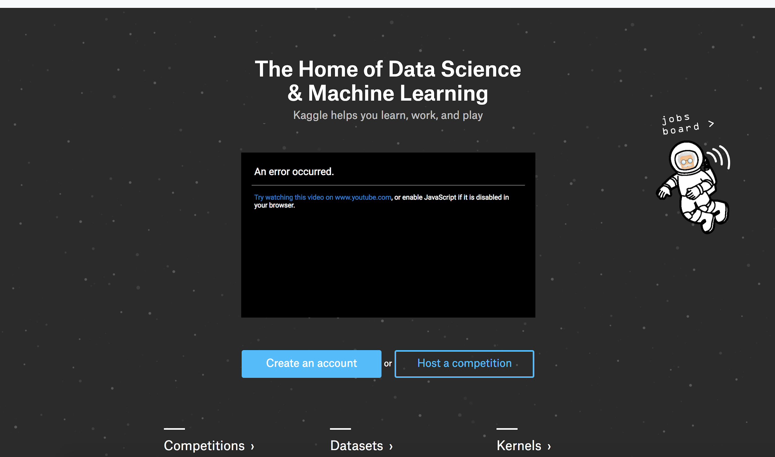

Slide 12

≠

Slide 13
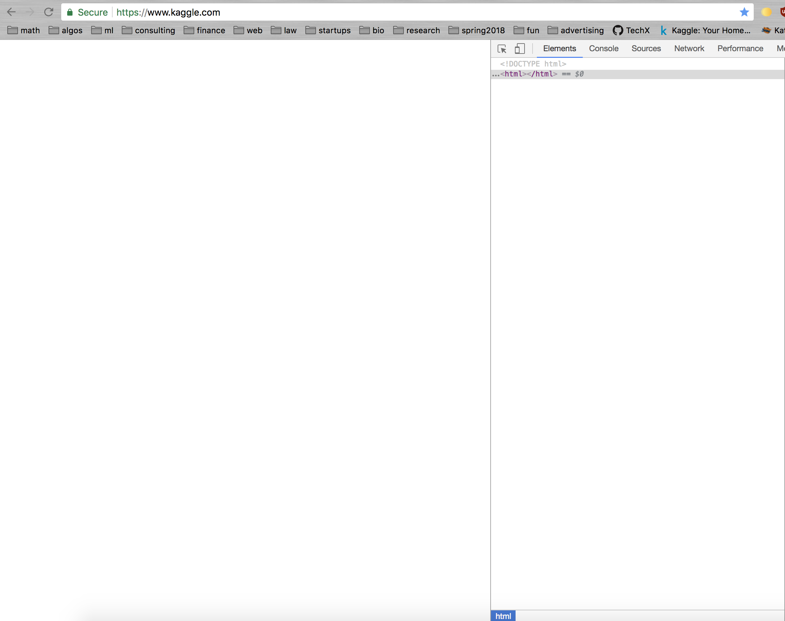

Slide 14
Now you try it! www.youtube.com
Notes:
Have them open the inspector and try this activity

Slide 15


What is HTML?
HyperText Markup Language
Tags tell browser what things are
<tag> …… </tag>
HTML says what things are, NOT how to show them
Browsers (Chrome, Firefox, etc.) read your HTML code and show it as a web page
Notes:
Good other slide: https://www.slideshare.net/MayaLisa/week-9-lecture-slides-and-audio

Slide 16
Document structure?

Slide 17


Slide 18
Header
Heading
Subheadings
Sidebar
Paragraphs
Main Content
Body
Notes:
This is an example of a webpage with many different tags and sections

Slide 19
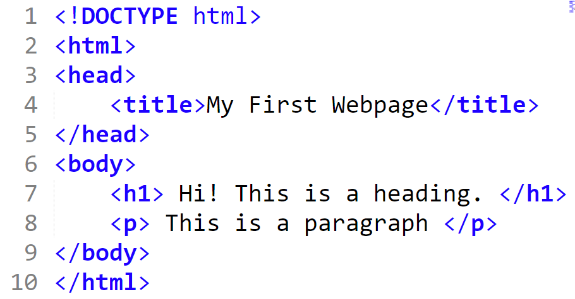
Creating Your First HTML Page
Notes:
It is !D

Slide 20
Creating Your First HTML Page
Notes:
It is !D

Slide 21
Creating Your First HTML Page
Tag that tells web browsers that you are using HTML so that they can show the page correctly
Notes:
It is !D

Slide 22
Creating Your First HTML Page
The <html> tag indicates where your html code starts and ends

Slide 23
Creating Your First HTML Page
The <html> tag indicates where your html code starts and ends

Slide 24
Creating Your First HTML Page

Slide 25
Creating Your First HTML Page
The <head> (not to be confused with <header>) tag is a container for elements such as the title for the document, scripts, styles, meta information, and more.

Slide 26
Creating Your First HTML Page
The <body> tag is the document’s body where it contains all of the content for the HTML document

Slide 27
Creating Your First HTML Page
What goes inside the <body> tag?
Headings (<h1>, <h2>,…)
Paragraphs (<p>)
Links (<a>)
Images (<img>)
Tables (<table>,…)
Sections (<div>)
Forms
Whatever you can dream of...

Slide 28
Creating Your First HTML Page
Use tags to describe the content.
<h1> means a heading
<p> means a paragraph

Slide 29
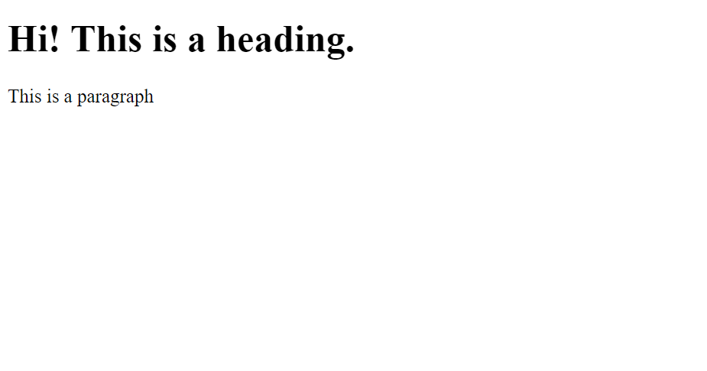

Slide 30
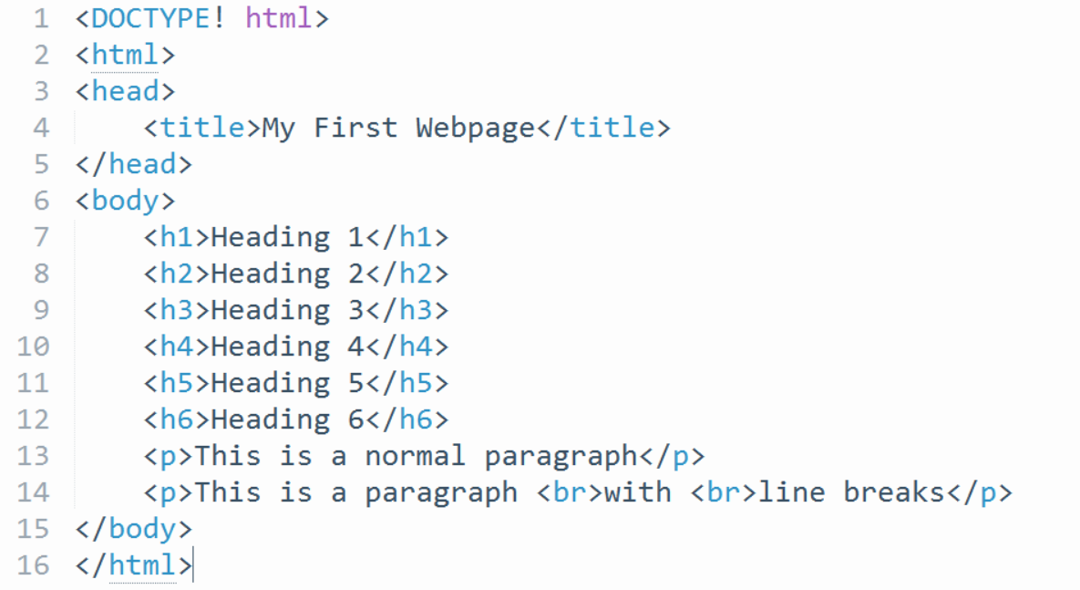
Basic tags
What do you think these tags do?

Slide 31
Basic tags
Different headings, of decreasing importance
A line break.

Slide 32
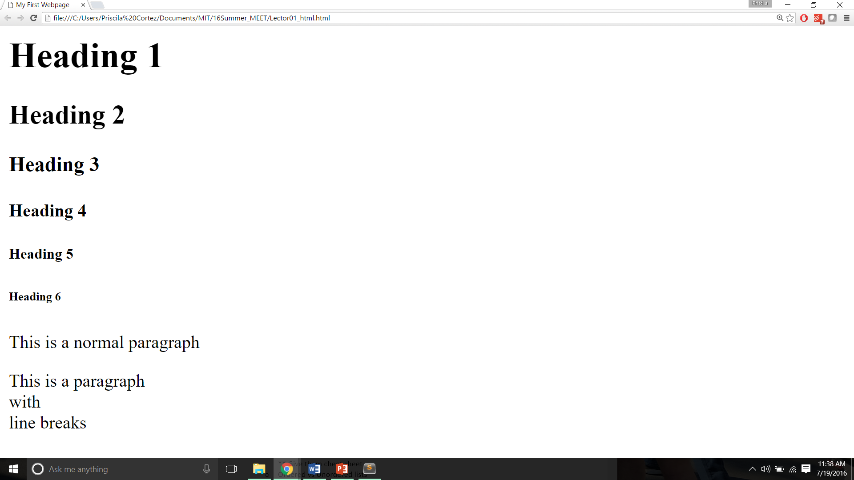
Headings
Line breaks

Slide 33
Lab 1: Basics Lab: go.meet.sh/html-lab Slides: go.meet.sh/html-day1 Cheatsheet: go.meet.sh/html-cheat

Slide 34
Attributes

Slide 35
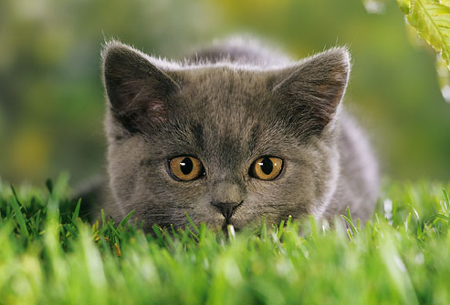
Tags with attributes
The <img> tag
<img src=”kitten.jpg” width=”152” height=”102”>

Slide 36
Tags with attributes
This tag needs attributes to specify what image to use and how big it should be:
<img src=”kitten.jpg” width=”152” height=”102”>
Attributes

Slide 37
Attributes
Attributes come in name/value pairs:
<img src=”kitten.jpg” width=”152” height=”102”>
Name
Value

Slide 38
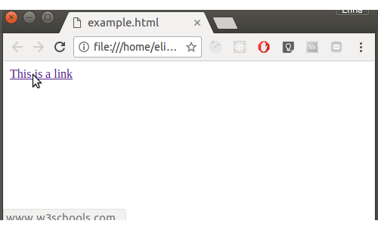
More tags with attributes
The <a> tag:
<a href="https://www.w3schools.com">This is a link</a>
href says what to link to

Slide 39
Recap
Some tags need attributes that contain information about what goes in the tag or what it does.
Examples:
<a href="https://www.w3schools.com">This is a link</a>
<img src=”kitten.jpg” width=”152px” height=”102px”>

Slide 40
The “style” Attribute
What is style?

Slide 41
The “style” Attribute
The visual aspects of a web page
In other words, how elements are displayed
color, background-color, font-family, font-size, text-align, and much more
We will go over this when we learn CSS

Slide 42
The “style” Attribute
Style can be specified as an attribute, but don’t do this, CSS will do it better later
In case you see it, however...
Syntax: <tagname style=“property:value;”>
Examples:
<p style=“color:blue;”>
<h1 style=“background-color: #909090; text-align:center;”>

Slide 43
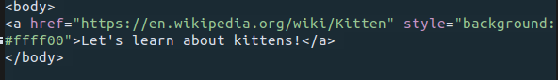
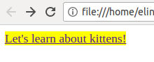
The “style” Attribute

Slide 44
Lab 2: Attributes Lab: go.meet.sh/html-lab Slides: go.meet.sh/html-day1 Cheatsheet: go.meet.sh/html-cheat

